Slide 1
Chapter 4
Queues
Objectives
Upon completion you will be able to:
Explain the design, use, and operation of a queue
Implement a queue using a linked list structure
Understand the operation of the queue ADT
Write application programs using the queue ADT
Explain categorizing data and queue simulation

Slide 2
What is a queue ?
A queue is a linear list in which data can be inserted at one end, called the rear, and deleted from the other end, called the front.
It is a first in – first out (FIFO) restricted data structure.

Slide 3
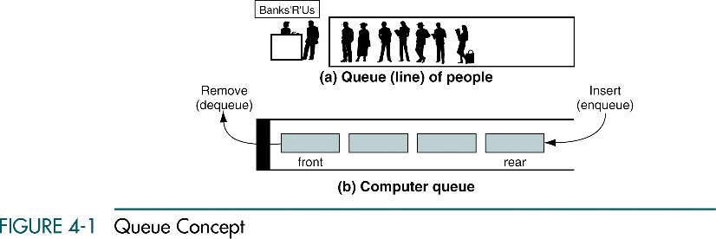

Slide 4
4-1 Queue Operations
This section discusses the four basic queue operations. Using diagrammatic figures, it shows how each of them work. It concludes with a comprehensive example that demonstrates each operation.
Enqueue
Dequeue
Queue Front
Queue Rear
Queue Example

Slide 5
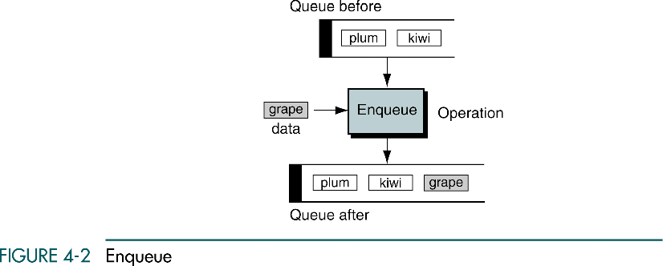
Enqueue
Enqueue inserts an element at the rear of the queue.

Slide 6
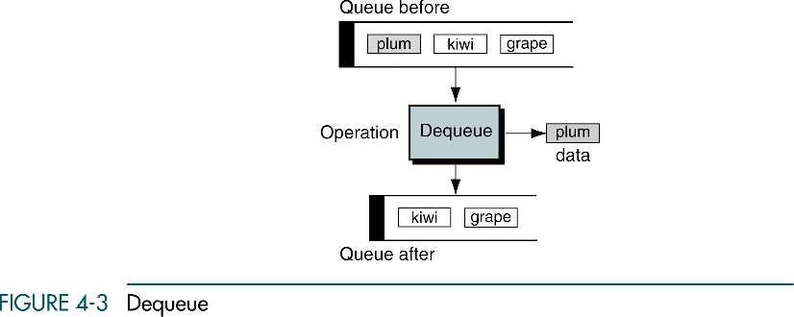
Dequeue
Dequeue deletes an element at the front of the queue.

Slide 7
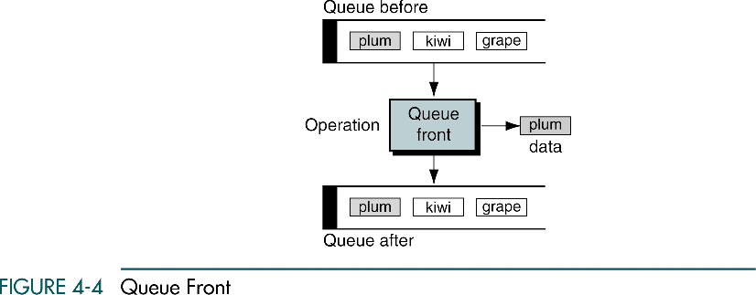
Queue front
Queue front retrieves the element at the front of the queue.

Slide 8
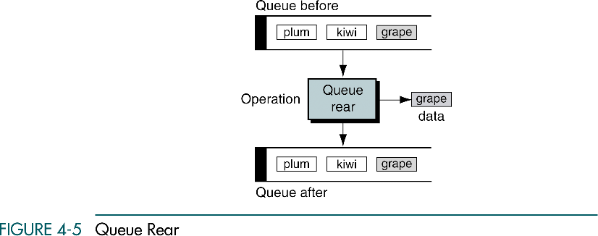
Queue rear
Queue rear retrieves the element at the rear of the queue.

Slide 9
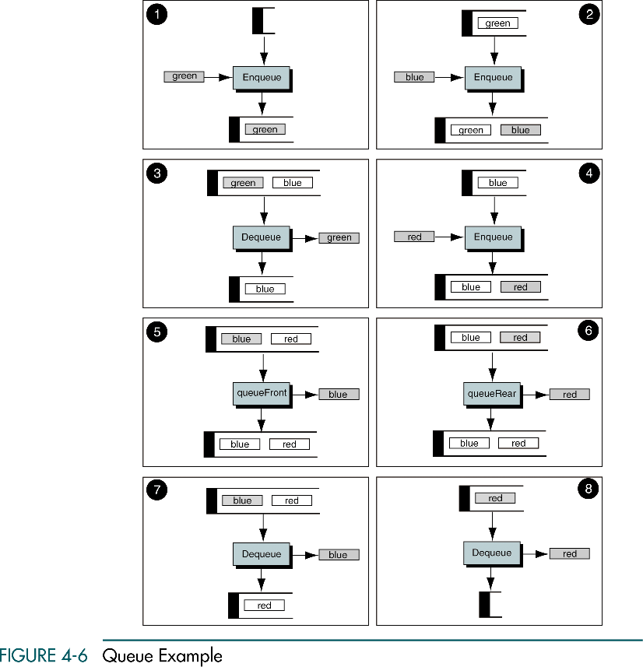

Slide 10
(Continued)

Slide 11
4-2 Queue Linked List Design
We first discuss the data structure for a linked-list implementation.
We then develop the eight algorithms required to implement a queue.
Data Structure Queue
Algorithms

Slide 12
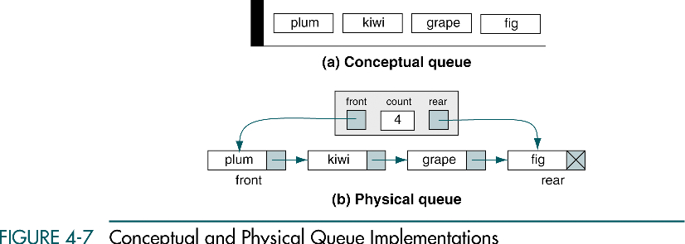

Slide 13
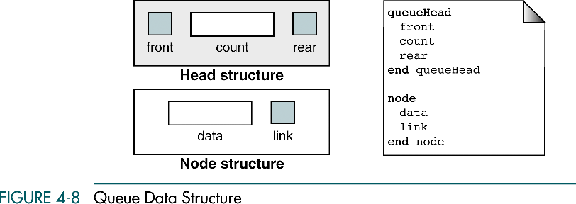
pointer

Slide 14
Queue algorithms
Create queue
Enqueue
Dequeue
Queuefront
Queuerear
Empty queue
Full queue
Queue count
Destroy queue

Slide 15
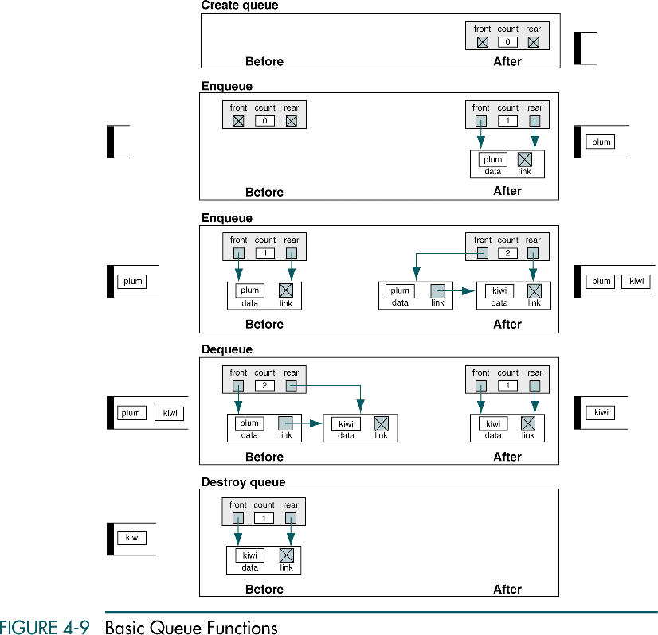

Slide 16
(Continued)

Slide 17
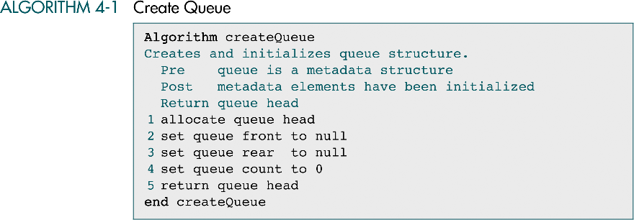

Slide 18
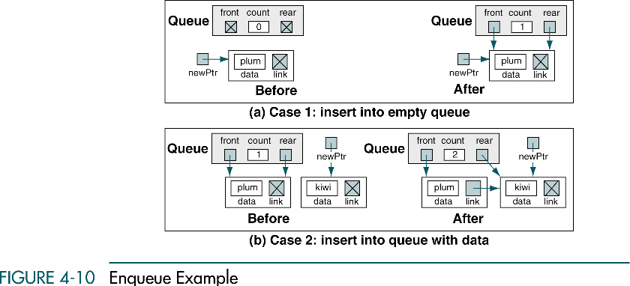

Slide 19
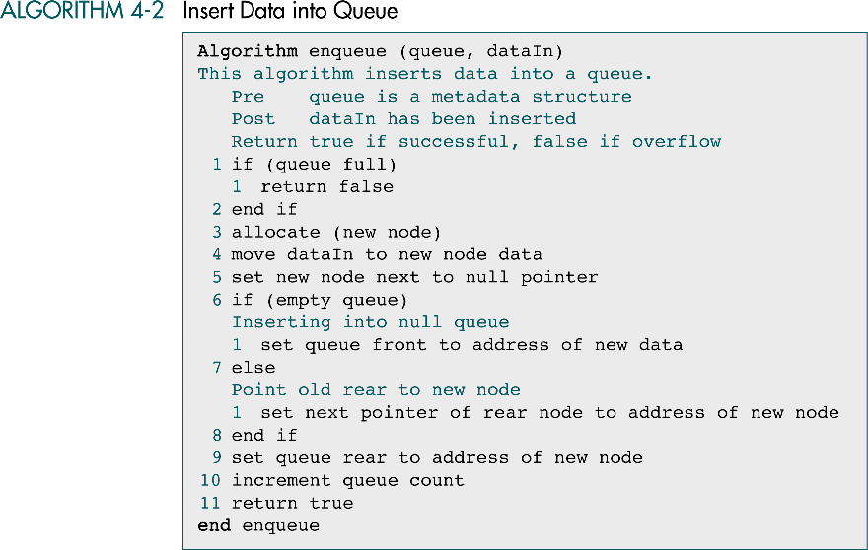

Slide 20
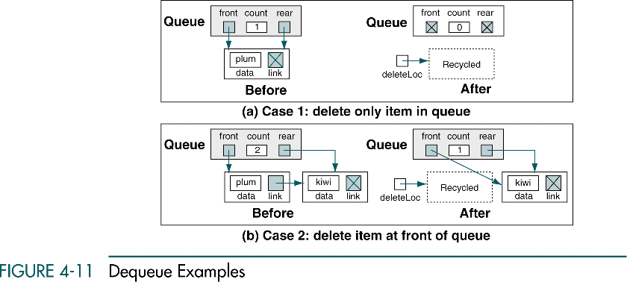

Slide 21
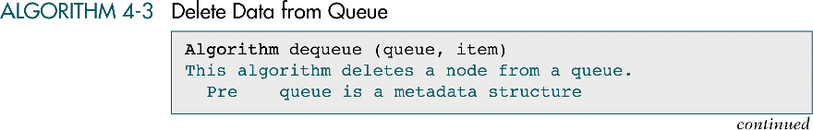
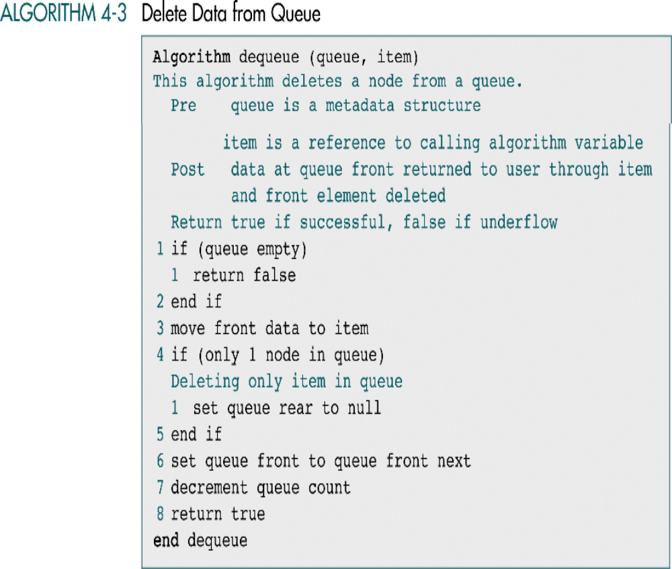
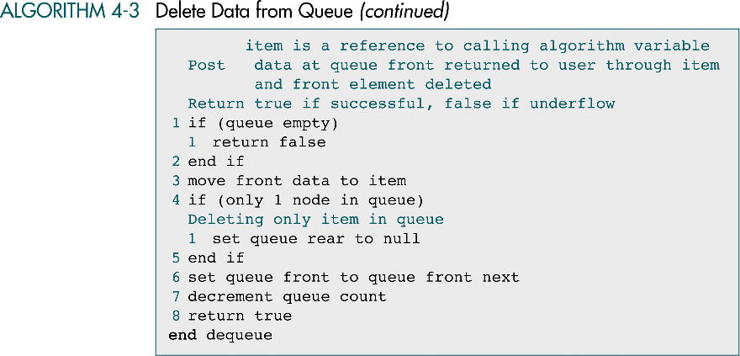

Slide 22
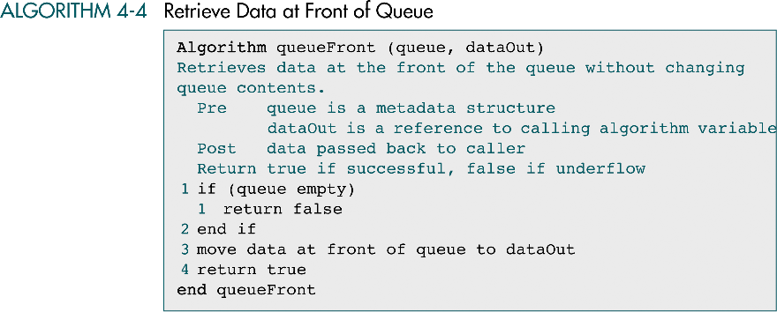

Slide 23
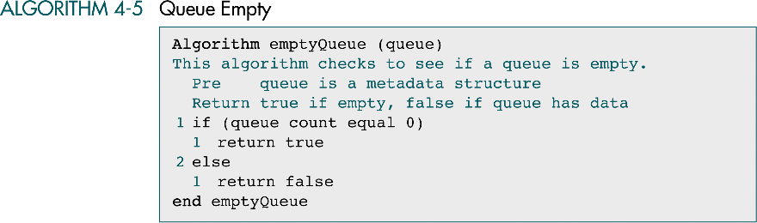

Slide 24
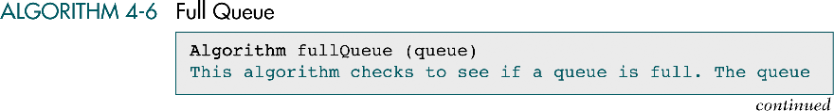
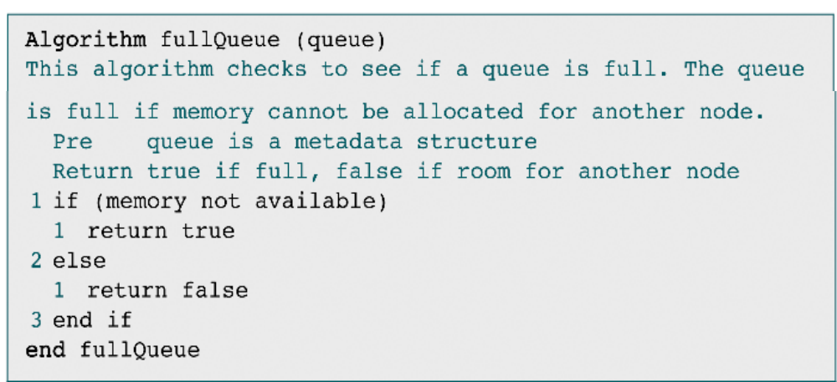

Slide 25
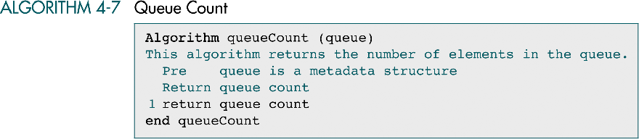

Slide 26
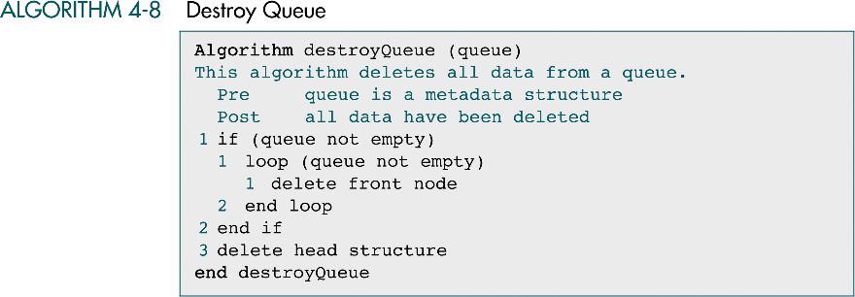

Slide 27
4-3 Queue ADT
This section develops the data structures and C code to
implement a Queue ADT. The first program contains
the data structure declarations and a list of the prototypes
for all of the functions. We then develop the C code for
the algorithms discussed in Section 4.2
Queue Structure
Queue ADT Algorithms

Slide 28
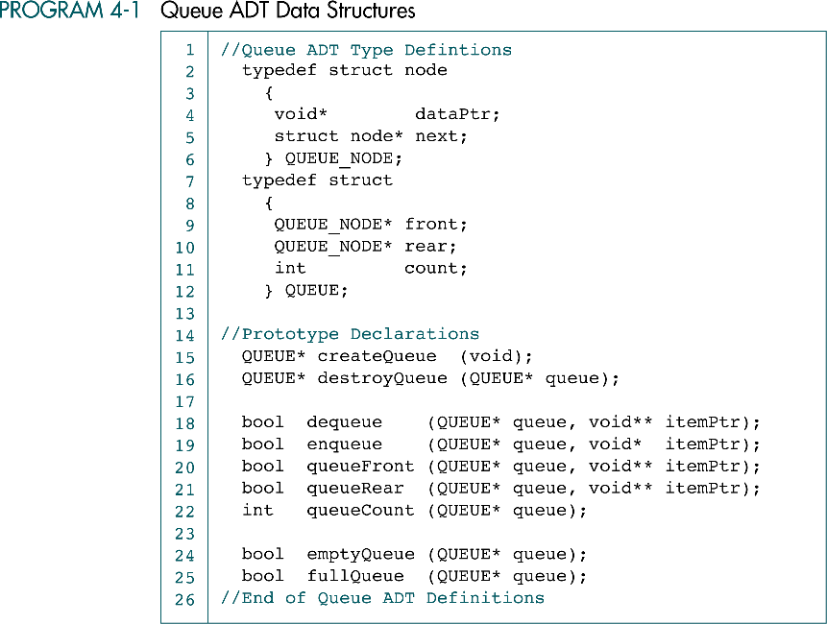

Slide 29
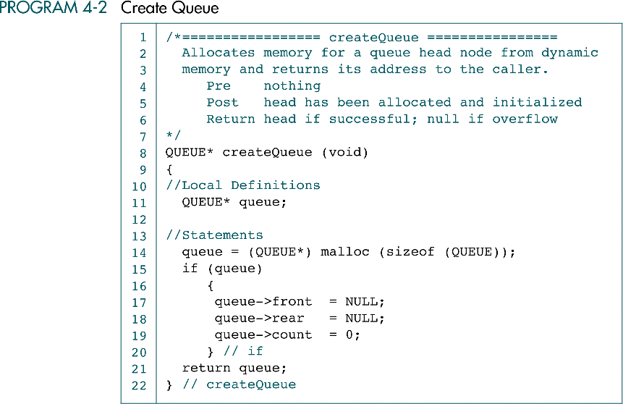

Slide 30
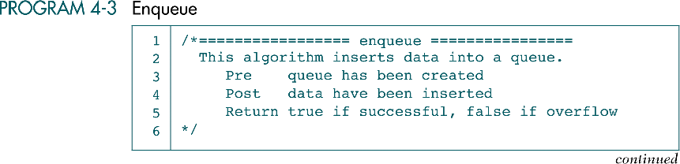

Slide 31
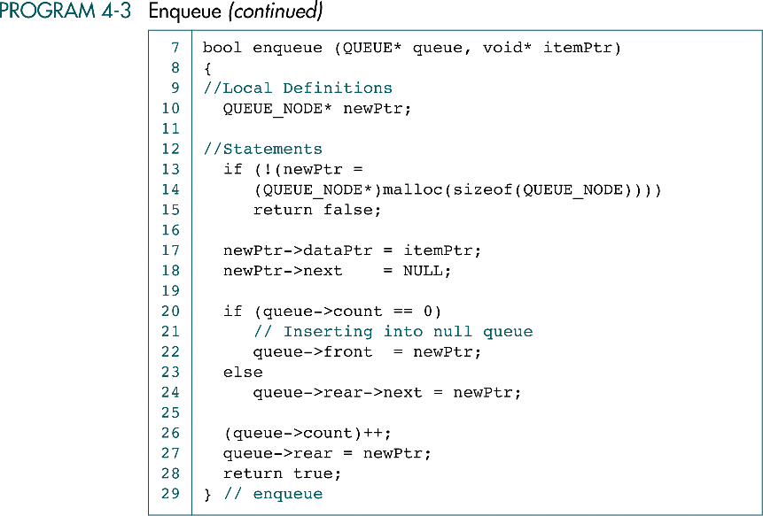

Slide 32
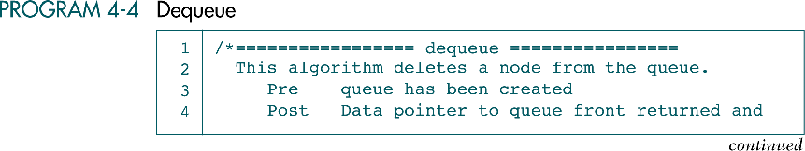

Slide 33
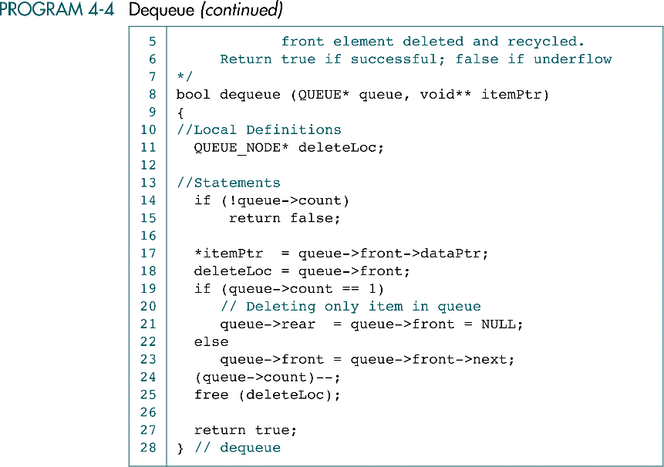

Slide 34
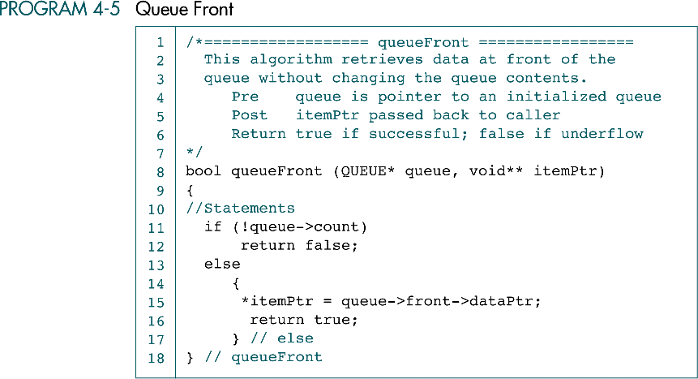

Slide 35
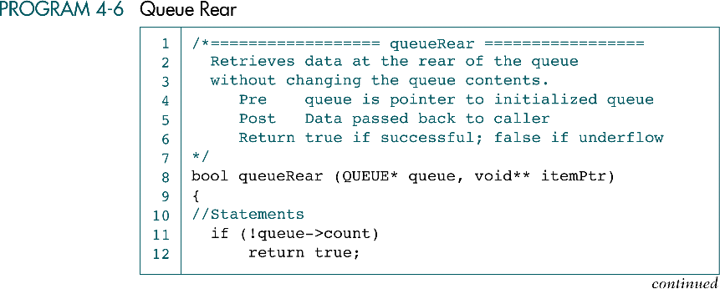

Slide 36
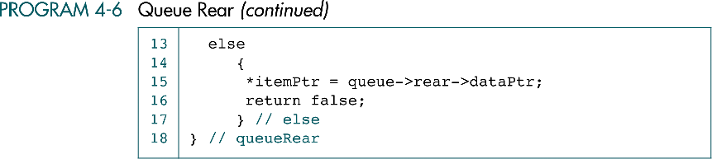

Slide 37
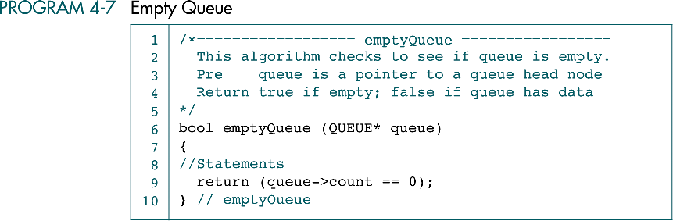

Slide 38
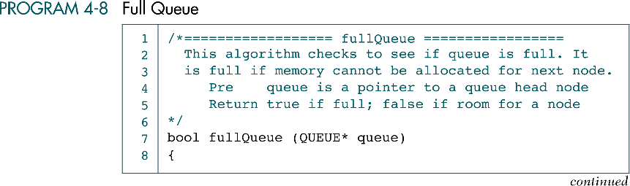

Slide 39
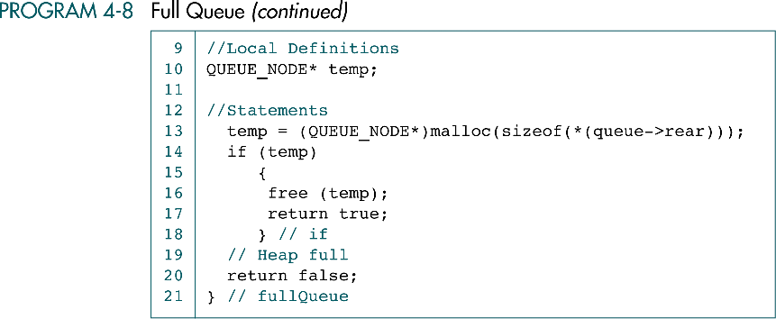

Slide 40
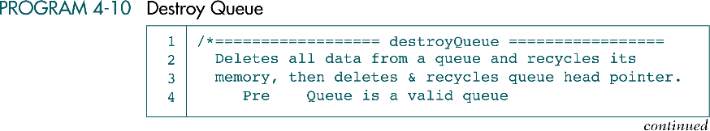

Slide 41
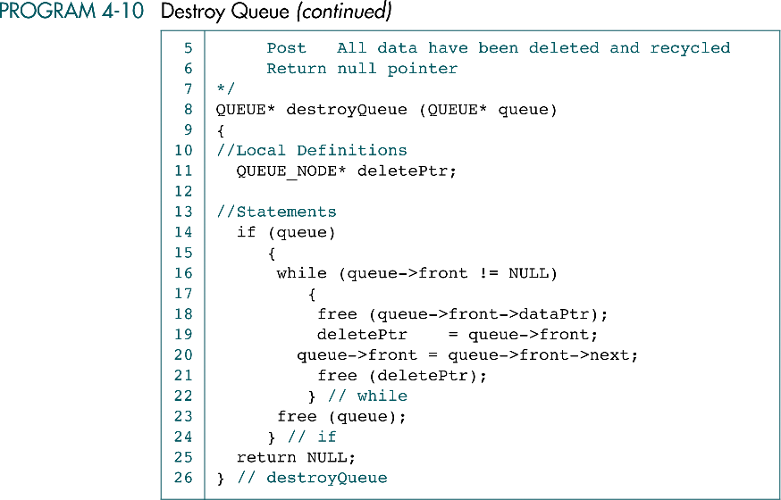

Slide 42
4-4 Queuing Theory
Queuing theory is a field of applied mathematics that is
used to predict the performance of queues. In this
section we review a few basic queuing theory concepts.

Slide 43
Queuing theory
Queuing theory is a field of applied mathematics that is used to predict the performance of queues.

Slide 44
Queue types
Single server queue
  Provide service to only one customer at a time.
Multiserver queue
  Provide service to many customers at a time.
Multiqueues, multiple single-server queues

Slide 45
Common queue elements
One or more customers
  A customer is any person or thing needing service.
Service
  The service is any activity needed to accomplish the required result.

Slide 46
Affected factors
Arrival rate
  The rate at which customers arrive in the queue for service.
Service time
  The average time required to complete the processing of a customer request.

Slide 47
Response time
The average time from the point at which customers enter the queue until the moment they leave the server.
queue time + average service time
  Queue time
    The average length of time customers wait in queue.
  Average service time
    The average time required to complete the processing of a customer request.

Slide 48
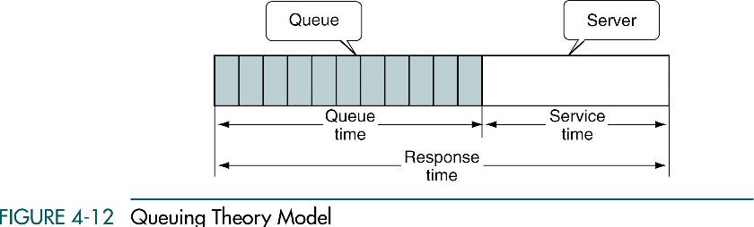

Slide 49
4-5 Queue Applications
We develop two queue applications. The first shows how to use a
queue to categorize data. The second is a queue simulator,
which is an excellent tool to simulate the performance and to
increase our understanding of its operation.
Categorizing Data
Queue Simulation

Slide 50
Categorizing data
It is often necessary to rearrange data without destroying their basic sequence.
Example
  3 22 12 6 10 34 65 29 9 30 81 4 5 19 20 57 44 99
  We want the list rearranged as shown below.
    Less than 10 : 3 6 9 4 5
    Between 10 and 19 : 12 10 19
    Between 20 and 29 : 22 29 20
    30 and greater : 34 65 30 81 57 44 99

Slide 51
Categorizing data design
Category queues
Fill category queues

Slide 52
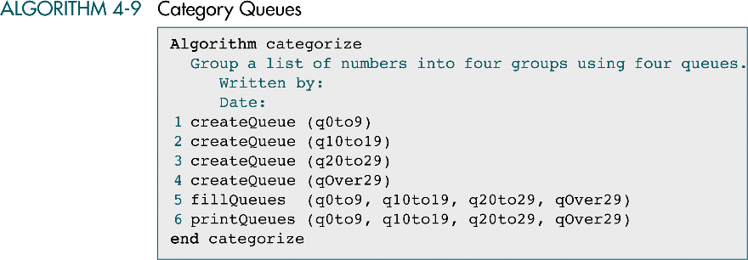

Slide 53
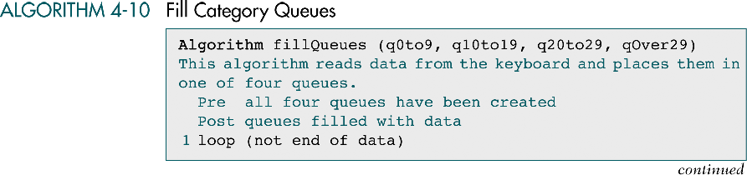
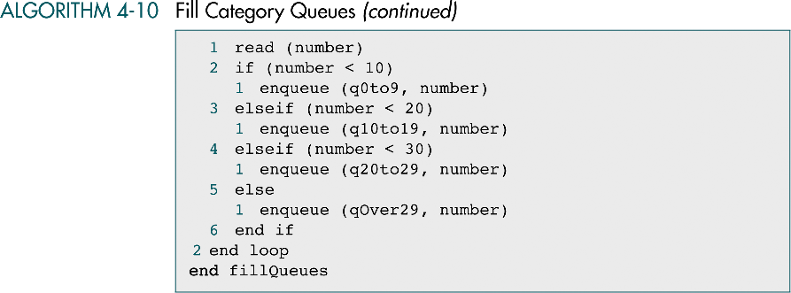

Slide 54
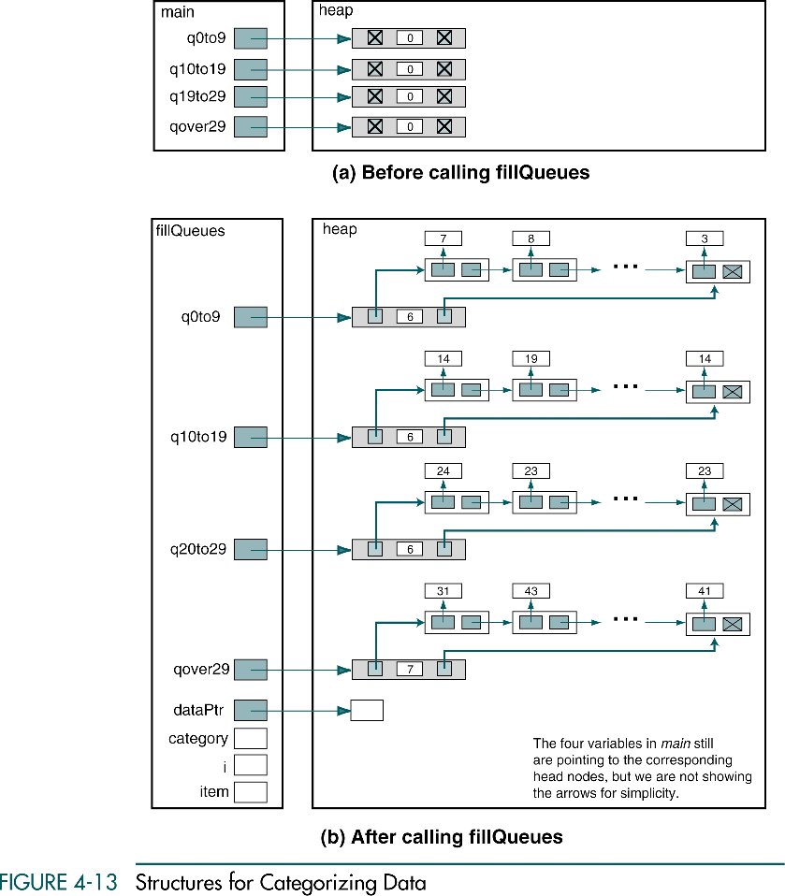

Slide 55
(Continued)

Slide 56
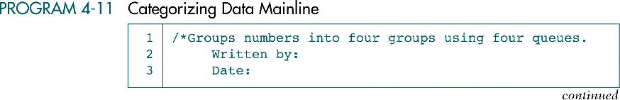
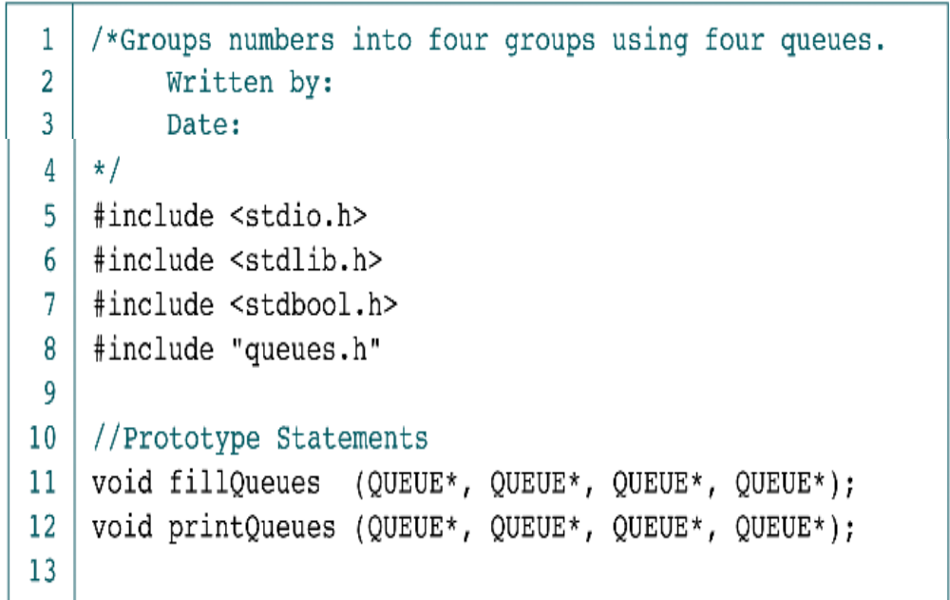

Slide 57
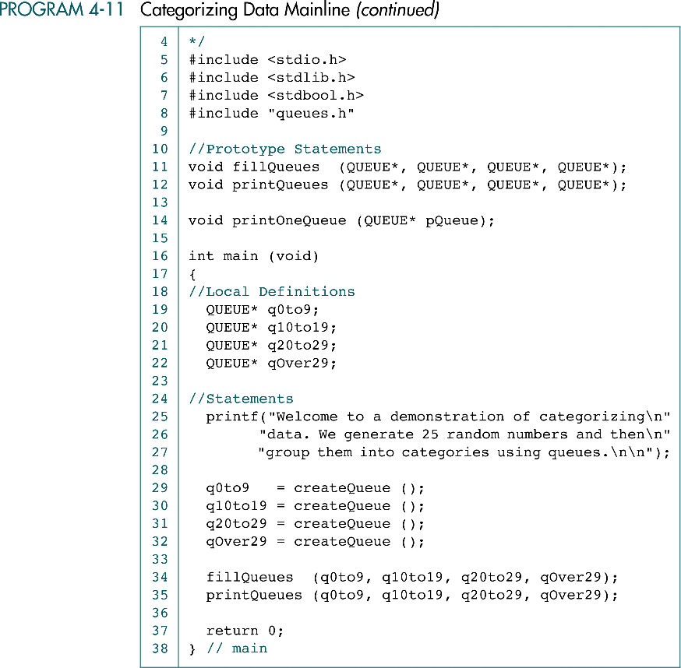

Slide 59
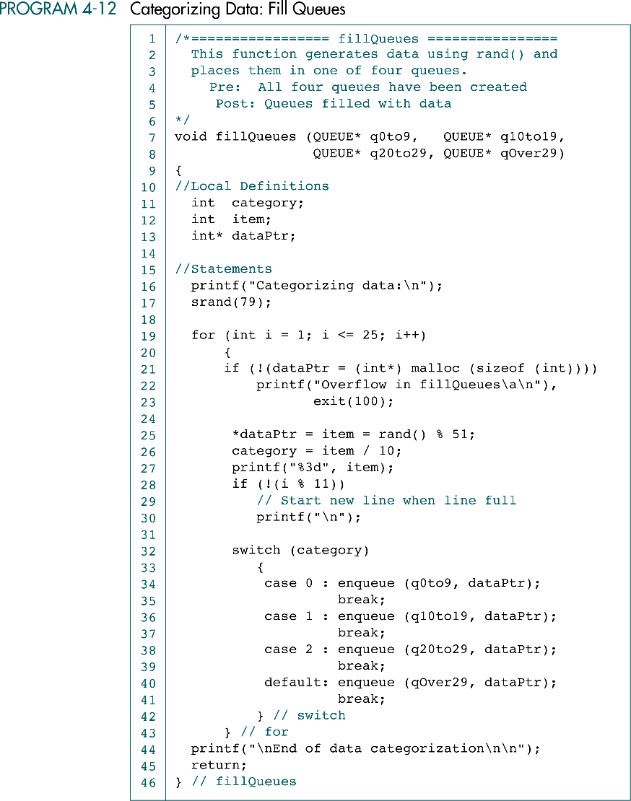

Slide 60
(Continued)

Slide 61
(Continued)

Slide 62
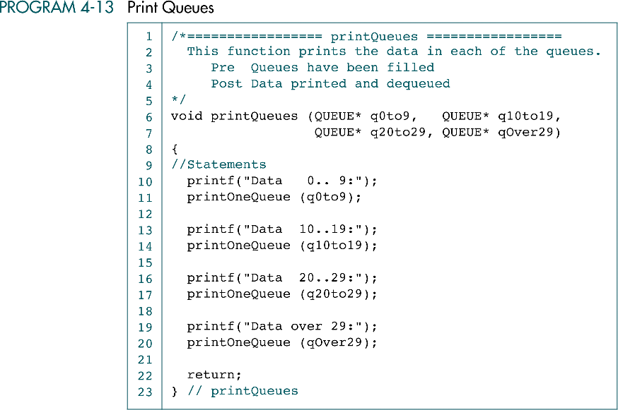

Slide 63
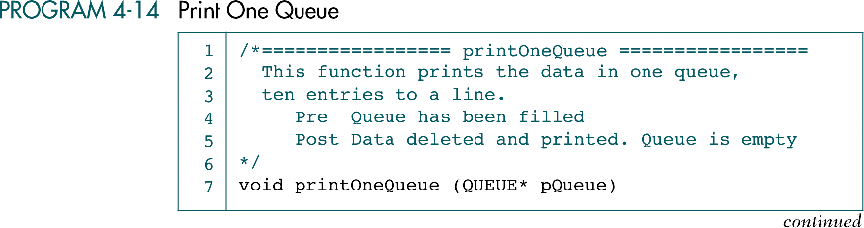

Slide 64
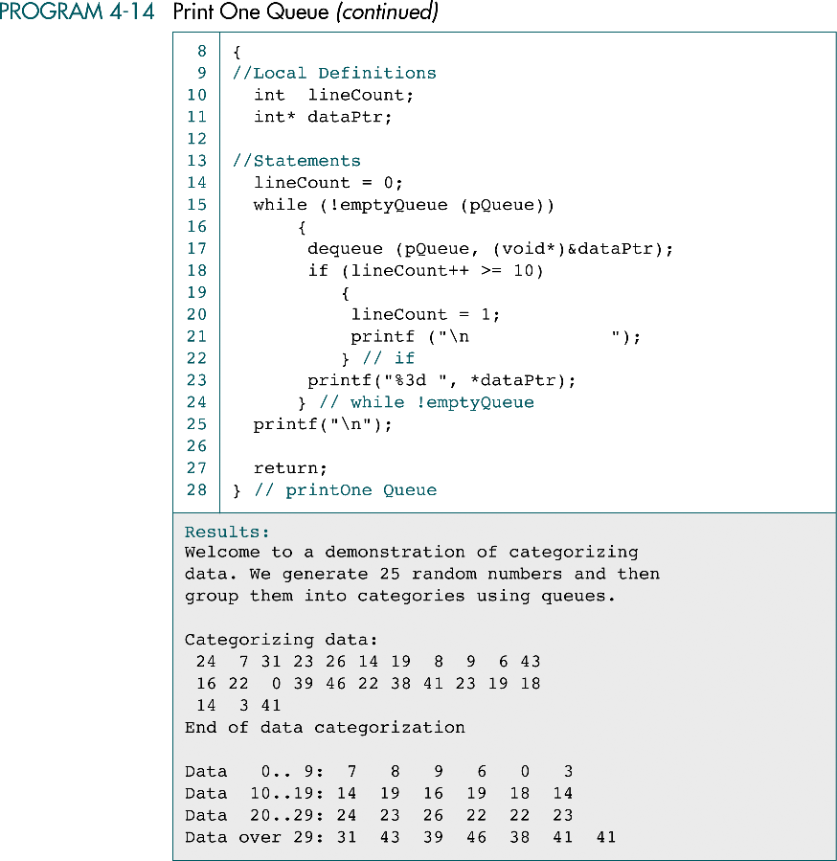

Slide 66
Queue simulation
We build a model of a single-server queue.
  The store is open 8 hours per day, 7 days a week.
  To simulate a day, we build a model that runs for 480 minutes (8 hours × 60 minutes).
clerk
New customer
window
queue

Slide 67
Queue simulation
The simulation uses a digital clock that events start and stop in 1-minute intervals.
In each minute of operation, three events will be checked:
  The arrival of customers
  The start of customer processing
  The completion of customer processing

Slide 68
Events
newCustomer
svcFree (svcStart)
svcComplete

Slide 69
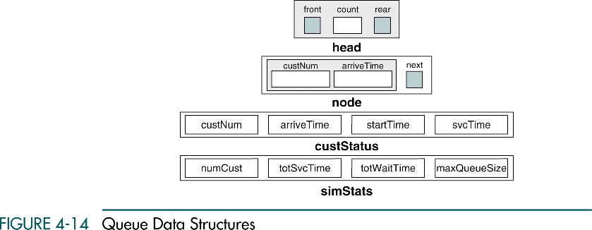
Queue head
Queue node
Customer status
Simulation statistics

Slide 70
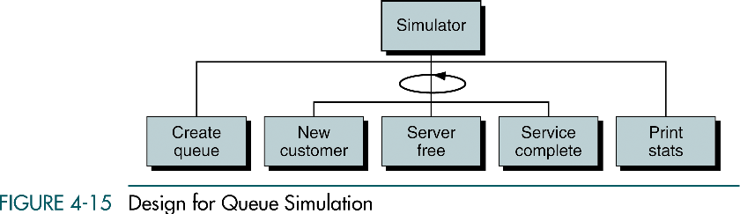

Slide 71

Flag moreCusts

Slide 72

Queue node
  custNum
  arriveTime

Slide 73

custStatus
  custNum
  arriveTime
  startTime
  svcTime

Slide 74


simStatus
  numCust
  totSvcTime
  totWaitTime
  maxQueueSize

Slide 75


Slide 76

An example
Four customers arrive at time 1, 2, 3 and 5.

Slide 77
An example
clocks events | 1 | 2 | 3 | 4 | 5 | 6 | 7 | 8
newCustomer | 1 | 2 | 3 |  | 4
svcFree (svcStart) | YES 1 |  | YES 2 | YES 3 |  |  | YES 4
svcComplete |  | YES 1 | YES 2 |  |  | YES 3 |  | YES 4

